Slide 1

NETFLIX DATA ANALYSIS
PRESENTED BY
SATHYANARRAYANAN

Slide 2

OBJECTIVE
Analyse Netflix's content and customer viewing behaviour to derive business insights.
Key Deliverables:
Power BI Dashboard with interactive visuals.
Show Analysis.
Customer Analysis.

Slide 3
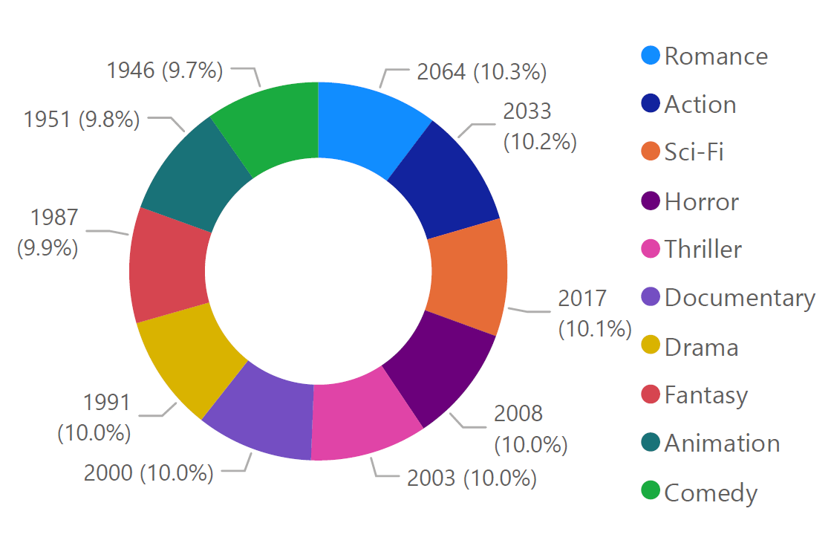
SHOWS BY GENRE
The data shows near-equal viewership distribution across 10 genres (all 9.7%-10.3%), with Romance (10.3%) and Action (10.2%) slightly leading, while Animation (9.8%) and Comedy (9.7%) trail. This suggests no dominant genre preference, highlighting diverse audience tastes.
Recommendation: Highlight top performers (Romance /Action) in featured content slots to capitalize on mild preference. Boost with themed campaigns (e.g., "Romance Month") or genre-blended recommendations (e.g., "Action-Horror Picks").
Solution: Create rotating spotlight pages for lesser-watched genres to drive discovery. Recommend "Sci-Fi + Comedy" pairings to expand viewership.

Slide 4
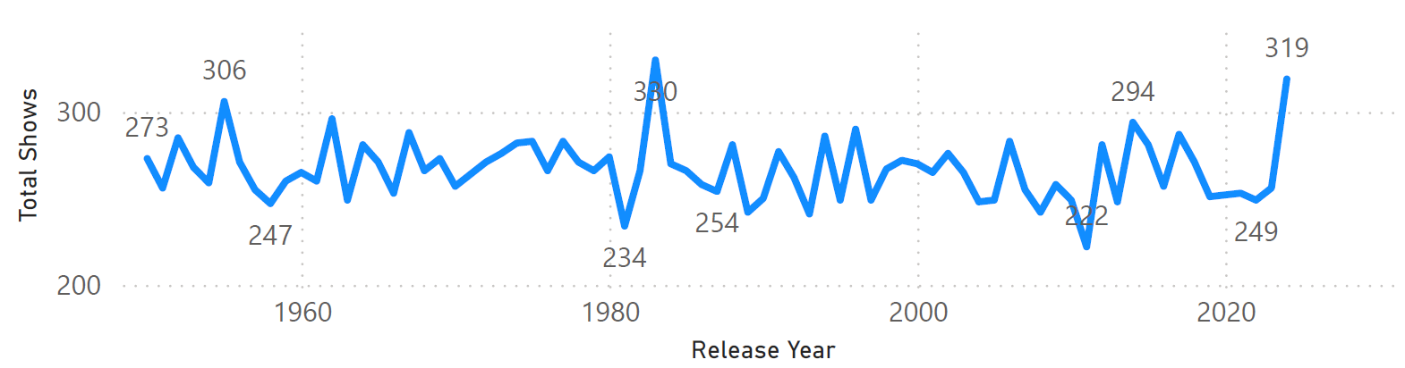
SHOWS RELEASE (PER YEAR)
The data displays total shows with numbers ranging from 222 to 330, alongside three years (1955, 1983, 2024) that may indicate production peaks or reference points. The wide range suggests variability in show output, with 330 as the highest count and 222 as the lowest.
Recommendation: Analyze the years (1955, 1983, 2024) to identify trends were these periods of high production or significant industry changes. Investigate the outliers (330 and 222) to understand what drove higher or lower show counts.
Solution: Compare show counts before/after key years (e.g., 1960, 2000) to spot patterns. Group shows by genre or format to see if certain types correlate with higher counts. Use historical data to predict future production needs and avoid over/under-supply.

Slide 5
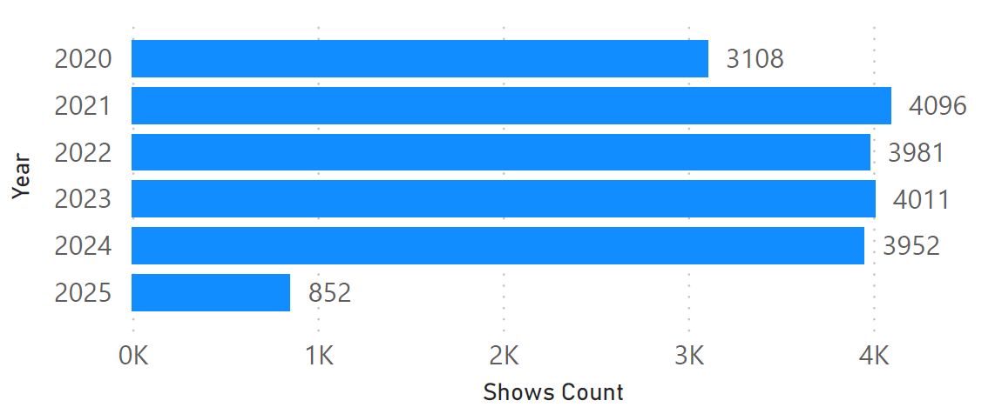
SHOWS ADDED BY YEAR
Steady growth from 2020 (3,108 shows) to 2021 (4,096 shows). Consistent production volume maintained 2021-2025 (around 3,950 to 4,100 shows/year), 2021 marked a significant 32% increase from 2020.
Recommendation: Investigate what drove the 2021 surge to replicate successful strategies. Maintain current production levels to meet demonstrated demand. Explore opportunities for controlled expansion beyond 4,100 shows/year.
Solution: Conduct 2021 success analysis (marketing, content mix, platform changes). Implement production optimization to sustain ~4,000 shows/year quality.

Slide 6
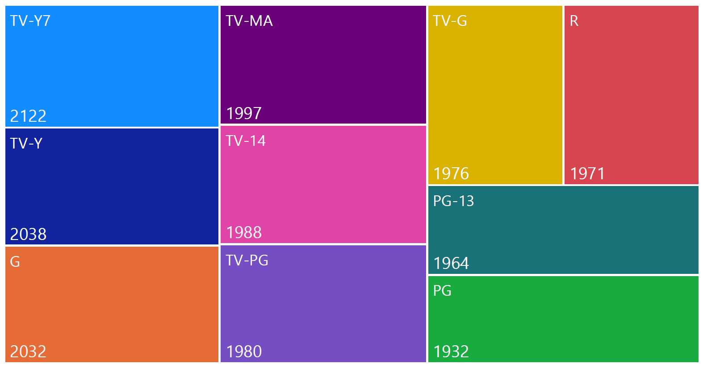
COUNT OF SHOWS BY RATING
Most shows are rated TV-Y7, indicating a large portion of Netflix content is meant for mature audiences. TV-Y and G follow, showing some family-appropriate content.
Recommendation: Focus on popular ratings (like PG-13 and TV-14) to attract younger audiences. Reuse older high-rated content (like G or PG) for family-friendly streaming.
Solution: Use AI to recommend shows based on ratings, remaster classic hits, and analyze trends to decide what new content to produce. This will boost viewer engagement and subscriptions.

Slide 7
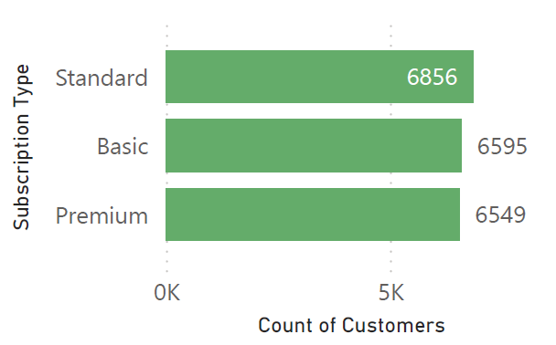
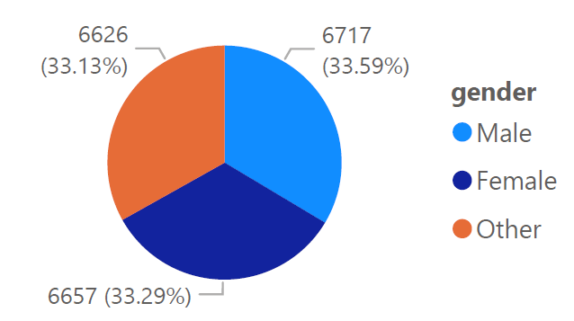
CUSTOMER & SUBSCRIPTION ANALYSIS
Nearly equal split among Standard (6,856), Basic (6,595), and Premium (6,549) tiers, indicating no strong customer preference for higher-tier plans. Balanced across Male (33.59%), Female (33.29%), and Other (33.13%), suggesting broad appeal but no gender-based skew in subscriptions.
Recommendation: Test incentives (e.g., "Premium for all: 1-month free trial") to boost upgrades uniformly across genders. Use gender-specific engagement data (e.g., Female users prefer Feature X) to tailor tier-promotion messaging.
Solution: Segment subscription counts by gender (e.g., "How many Female users choose Premium?") to identify hidden patterns. If data shows Male users dominate Basic plans, create ads highlighting Premium features aligned with their usage (e.g., "Male-focused: Unlock advanced analytics").

Slide 8
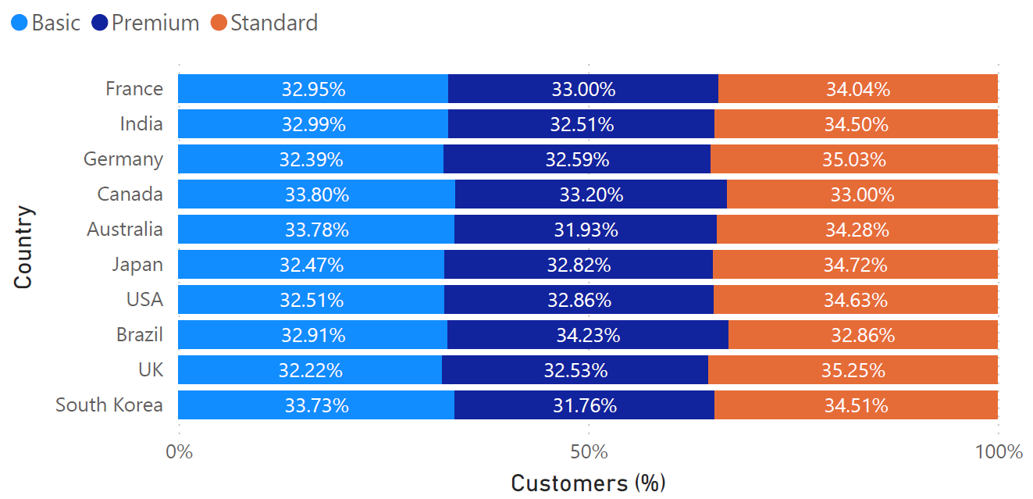
CUSTOMER & SUBSCRIPTION ANALYSIS

Slide 9
CUSTOMER & SUBSCRIPTION ANALYSIS
Standard plan dominates in 9/10 countries (34-35% share), while Premium leads only in Brazil (34.23%). Basic and Premium adoption is nearly equal globally (32-33%), with slight variations - Basic underperforms in Australia/South Korea (<32%), and Canada shows the most balanced distribution (33-34% across all plans).
Recommendation: Promote Standard as the flagship plan in most markets while targeting Brazil with Premium focused campaigns. Boost Basic adoption in low performing countries (e.g., Australia/South Korea) with discounts or added features.
Solution: Lower Premium costs in Australia/South Korea and highlight Premium perks in Brazil. Add region specific benefits (e.g., local content in Standard for European markets). Label Standard as "Most Popular" in 9 countries but test Premium upsell tactics in Brazil.

Slide 10
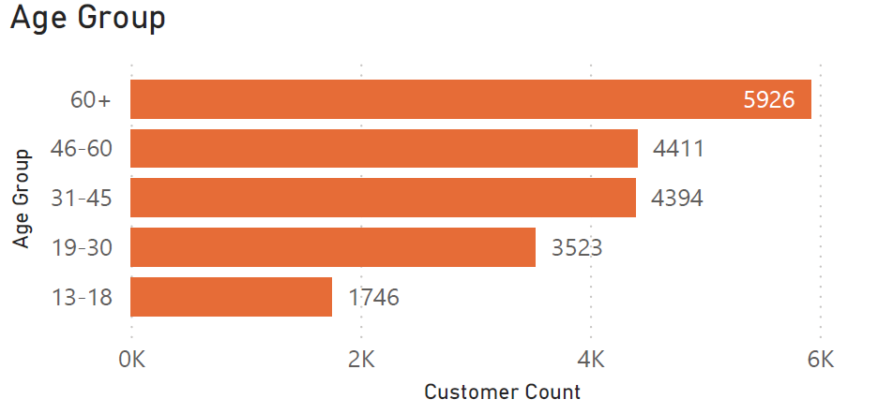
CUSTOMER AGE GROUP
Customer distribution across age groups, with the highest counts in 60+ (5,926) and 46-60 (4,411) segments, followed by 31-45 (4,394). Younger groups (13-18: 1,746 & 19-30: 3,523) have significantly lower representation.
Recommendation: Target high-engagement groups (60+, 46-60) with tailored offers to maximize retention. Develop strategies to attract younger groups (13-18, 19-30) through specialized campaigns or products.
Solution: Create age-specific promotions (e.g., discounts for 13-18, loyalty programs for 31-45). Introduce features or services appealing to older users (e.g., accessibility options for 60+). Investigate why younger groups are underrepresented and adjust outreach accordingly.

Slide 11
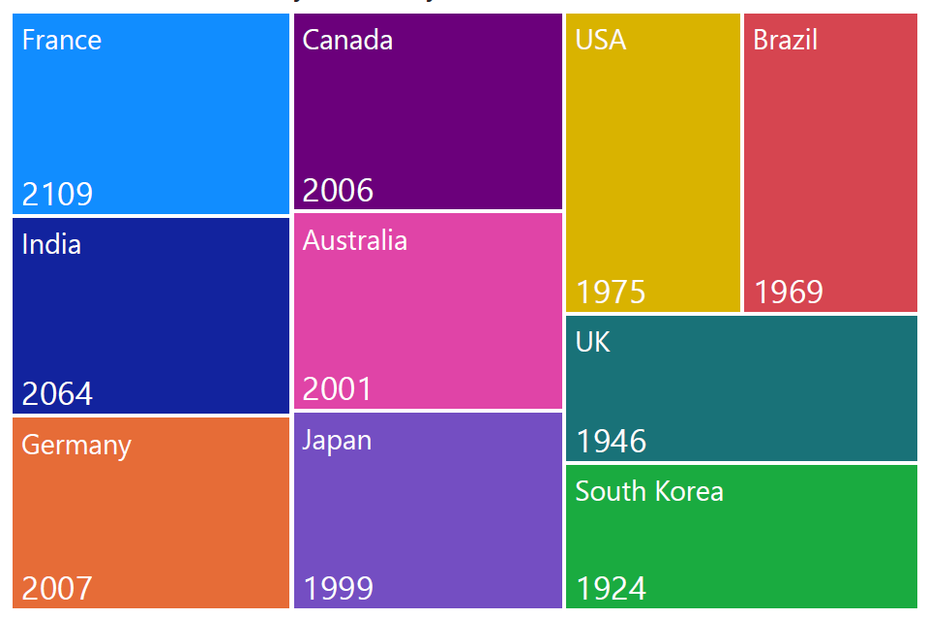
CUSTOMER COUNT BY COUNTRY
The data displays customer counts across 10 countries, with France (2,109) and India (2,064) having the highest numbers, while South Korea (1,924) and UK (1,946) show the lowest. The USA, Brazil and others fall in between (1,946-2,007), indicating even market penetration.
Recommendation: Strengthen presence in high-potential markets (France, India) with localized campaigns. Boost engagement in underperforming regions (South Korea, UK, Brazil) through targeted promotions or partnerships.
Solution: Customize offerings for top markets (e.g., language support in India, cultural relevance in France). Introduce referral programs or discounts in low count countries (e.g., Brazil, UK, South Korea).

Slide 12
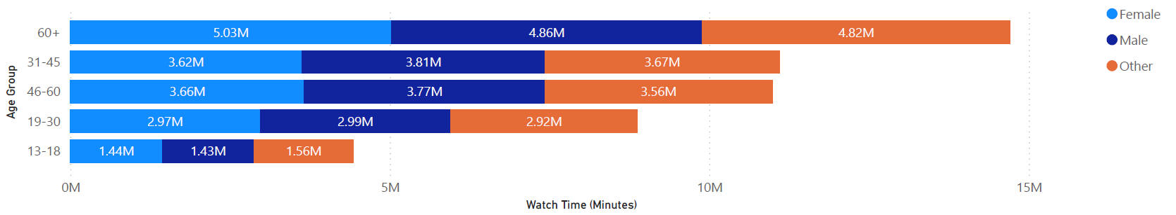
WATCH TIME BY GENDER & AGE GROUP
Customer distribution across age groups and genders, with Highest representation in 60+ age group (peaking at 15M). Significant numbers in 31-45 and 46-60 groups (3-5M range).
Recommendation: Focus retention efforts on the large 60+ customer segment. Develop targeted products/services for the substantial middle aged & younger demographics (13-60).
Solution: Create age specific loyalty programs (especially for 60+ segment). Launch marketing campaigns tailored to 13-30 age groups needs.

Slide 13
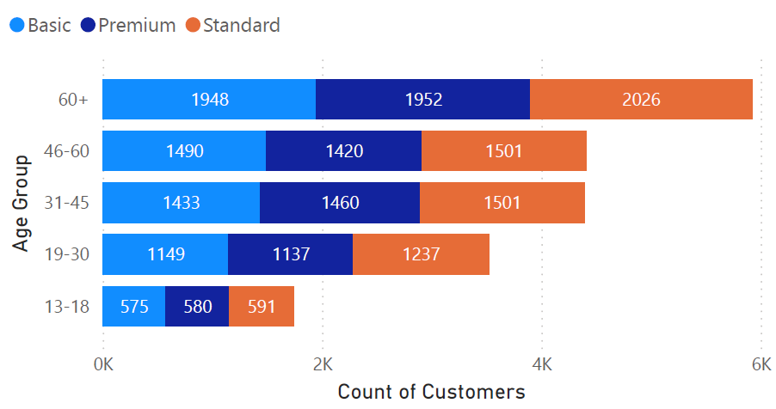
SUBSCRIPTION ANALYSIS
Subscription plan distribution across age groups, Older customers (60+) prefer Standard plans (2,026) over Basic/Premium, Younger groups (13-30) show balanced plan adoption. Standard plans lead in every age category.
Recommendation: Develop premium features targeting older demographics (60+), create youth-focused Basic plan bundles (13-30 age groups). Highlight Standard plan benefits across all marketing.
Solution: Launch "Silver Premium" tier with senior friendly features. Introduce student discounts for Basic plans and use age based plan recommendations in onboarding flows.

Slide 14
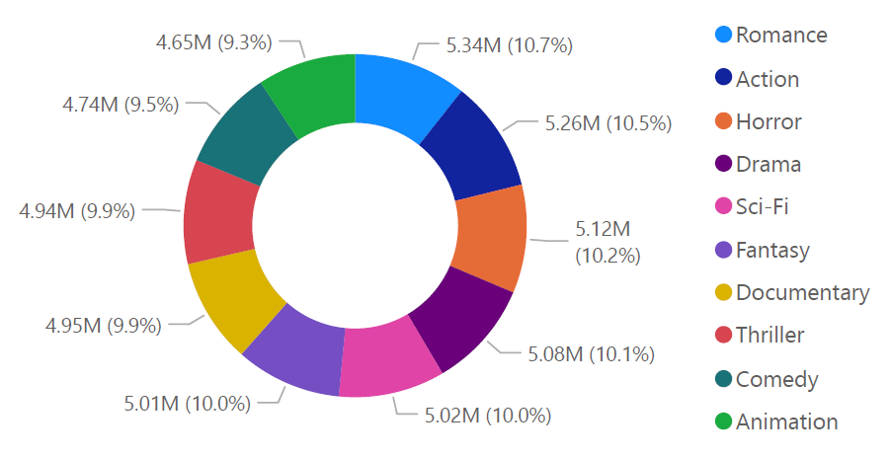
WATCH TIME BY GENRE
Customer preferences across 10 movie/TV genres, with near-equal distribution (9.3%-10.7%). Romance (10.7%) and Action (10.5%) lead slightly, while Animation (9.3%) and Comedy (9.5%) trail marginally. No genre dominates, indicating diverse viewer tastes.
Recommendation: Boost Comedy/Animation with curated collections or cross genre promotions (e.g., "Romantic Comedies"). Leverage top genres (Romance/Action) for featured content slots or original productions.
Solution: Pair popular (Romance) with lesser watched (Comedy) in recommendations. Genre based campaigns like "Action Week" or "Comedy Spotlight" to drive engagement. Invest in underrepresented genres if supply doesn’t match demand.

